Slide 1
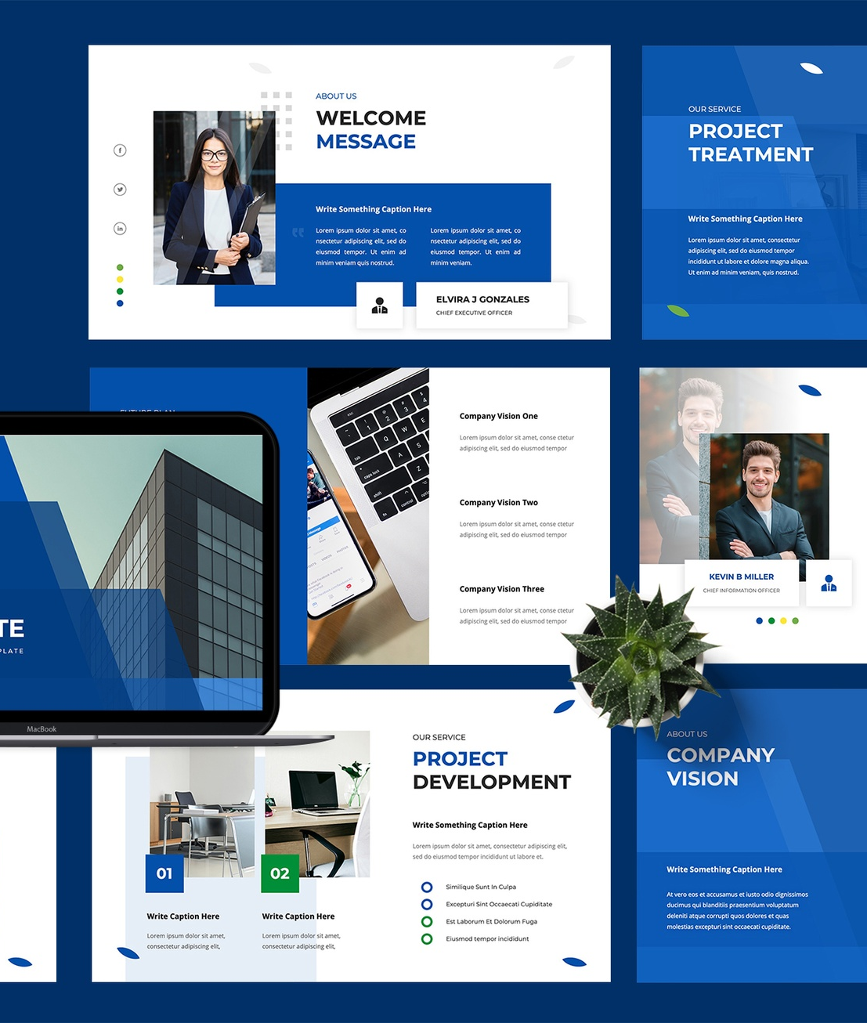
Infosys_FoodTrends: Understanding Customer Preferences – Batch_11 Team C
Analyzing food trend data to gain insights into customer preferences for the food and beverage industry
Team Members:
Vaishnavi Shah
Sam Joseph
Yamini Maheswari
Piyush Nitnaware
Harini M
Ragav Vyas
Mentor Name: Nityasree J

Slide 2
Problem Statement
Evolving Customer Preferences
Lack of Proper Analysis
Food businesses face challenges in identifying evolving customer preferences due to large and diverse datasets.
Without proper analysis and visualization, valuable insights related to food trends, customer behavior, and demand patterns remain unexplored.
Large and Diverse Datasets
Unexplored Insights
Food businesses struggle to extract meaningful insights from the large and diverse datasets they have access to.
Valuable insights related to food trends, customer behavior, and demand patterns remain unexplored due to the lack of proper analysis and visualization.

Slide 3




Objectives
Analyze food trend data
Identify popular and emerging food categories
Study customer behavior patterns
Provide data-driven insights for business strategy
Leverage data analytics to understand evolving customer preferences in the food industry
Analyze customer interaction data to gain insights into demand trends and preference shifts
Discover the most preferred and up-and- coming food categories based on customer behavior
Derive meaningful insights to help food businesses enhance their offerings and customer satisfaction
By achieving these objectives, the Infosys_FoodTrends project aims to empower food businesses with data-driven decision-making and a deeper understanding of customer preferences.

Slide 4
Project Milestones
Milestone 1
Milestone 3
Data Collection & Understanding
Visualization & Dashboard Creation
Collected Zomato Restaurants Dataset from Kaggle Studied dataset structure, features, and data quality Dashboard 1: Dataset overview & basic statistics
Analyzed ratings, cuisines, cost, and delivery options Identified patterns using charts and filters Dashboards 4–6: Ratings analysis, cuisine trends, cost vs rating
Milestone 2
Milestone 4
Data Analysis & Trend Identification
Insights & Recommendations
Handled missing and inconsistent values Standardized cuisine, rating, and cost fields Dashboards 2–3: Cleaned data validation & category distribution
Extracted key insights from dashboards
Prepared conclusions and project documentation Dashboard 7: Final insights & summary dashboard

Slide 5
Challenges Faced
Missing values
Inconsistent entries
Data formatting issues
Dataset contained several missing values across different fields that required thorough cleaning and imputation
Cuisine categories, restaurant names, and other fields had high variability in formatting and terminology
Ratings and location fields had inconsistent formatting and structures that required extensive data preprocessing
High cuisine category variation
Outliers in cost and votes
Cuisine types were highly diverse with many overlapping and ambiguous categories that needed to be consolidated
Extreme outliers in restaurant cost and customer votes had to be identified and handled appropriately

Slide 6


Key Insights
Identification of highly preferred food categories
Demand-driven food trend patterns
Our data-driven approach enabled us to uncover demand-driven patterns and correlations in food trends, informing strategic decision-making.
Our analysis revealed the most popular and in-demand food categories based on customer interactions and demand patterns.
Importance of data visualization for insights
Changing customer preferences over time
Interactive dashboards and visualizations played a crucial role in effectively communicating the key insights derived from the food trend analysis.
We tracked how customer preferences shifted and evolved, identifying emerging food trends and changing consumption behaviors.
The key insights from the Infosys_FoodTrends project provide valuable data-driven intelligence to help food businesses stay ahead of the curve and cater to evolving customer preferences.

Slide 7



Future Scope
Integrate Real-Time Data Sources
Leverage Advanced Analytics & AI
Expand Analysis Across Regions/Platforms
Incorporate real-time data feeds from various channels to capture evolving customer preferences and trends in a timely manner.
Apply machine learning models and artificial intelligence techniques to uncover deeper insights and predictive patterns from the data.
Extend the analysis to cover multiple geographic regions or digital platforms to identify global or platform-specific customer behavior trends.
By integrating real-time data, harnessing advanced analytics, and expanding the analysis scope, the Infosys_FoodTrends project can continue to provide more comprehensive and impactful insights to drive informed business decisions.

Slide 8
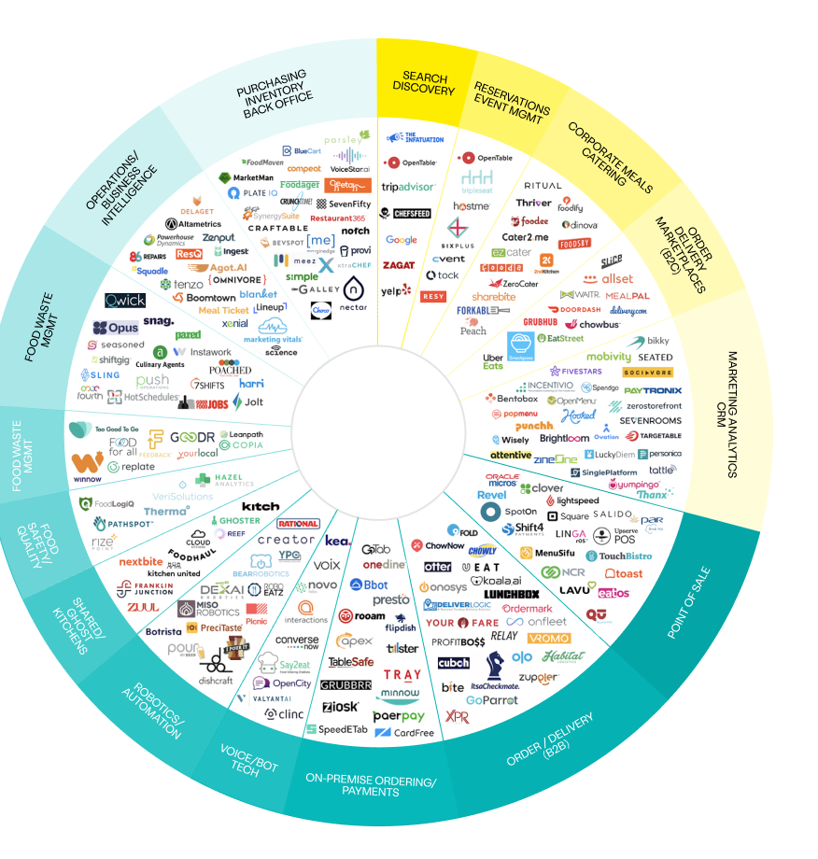
Conclusion
The Infosys_FoodTrends project highlights how data analytics can be effectively used to understand evolving customer preferences in the dynamic food and beverage industry. The insights derived from the analysis support informed decision-making and lead to improved business outcomes for food businesses.

Slide 9
Acknowledgement & References
Acknowledgement
References
Restaurants Dataset, Kaggle https://www.kaggle.com/datasets/yashsahu02/zomato- restaurants-dataset
Zomato platform (for domain understanding)
Project dashboards and analysis created during the study
I would like to express my sincere gratitude to my mentor for their valuable guidance and continuous support throughout this project.
I also thank the Infosys team for providing the opportunity and learning environment to work on this project. Special thanks to Kaggle and the data contributors for making the dataset publicly available.

Slide 10

Thank You!

